Slide 1
Three Treaties
– broken and restored
Waitangi Day, 2019

Slide 2
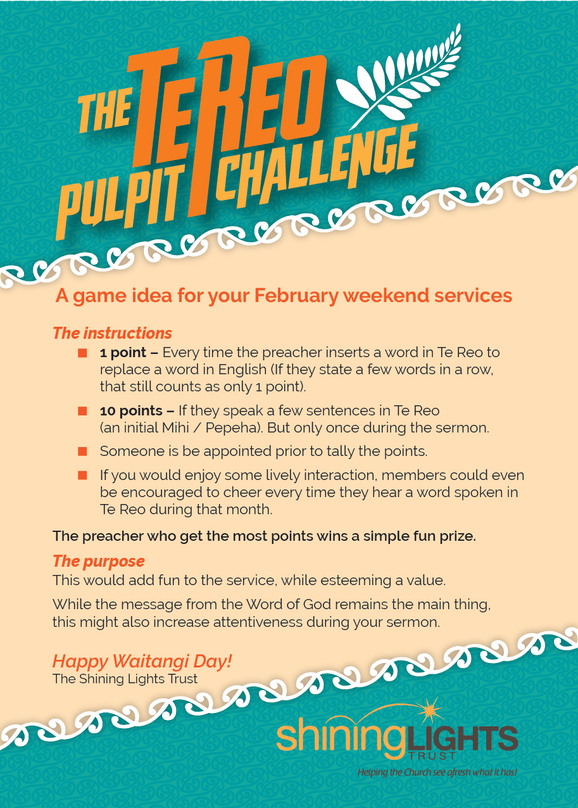
Three Treaties
– broken and restored

Slide 3
#1. Te Tiriti o Waitangi
Our nation’s founding document
(6 February, 1840)
Three Treaties
– broken and restored

Slide 4
#1. Te Tiriti o Waitangi
Our nation’s founding document
(6 February, 1840)
A document for all New Zealanders
Tangata Whenua
Tangata Tiriti
Three Treaties
– broken and restored

Slide 5
#1. Te Tiriti o Waitangi
Made in the names of the highest available authorities
Various Maori Rangatira
Three Treaties
– broken and restored

Slide 6
#1. Te Tiriti o Waitangi
Made in the names of the highest available authorities
Various Maori Rangatira
Hobson, as representative of the Queen
of England, as representative of God
Three Treaties
– broken and restored

Slide 7
#1. Te Tiriti o Waitangi
Made in the names of the highest available authorities
Various Maori Rangatira
Hobson, as representative of the Queen
of England, as representative of God
…plus the affirmation of missionaries,
whom many Maori trusted.
Three Treaties
– broken and restored

Slide 8
#2. The Treaty with the Gibeonites
Part I: The Gibeonite deception
(Joshua 9)
Part I: The Gibeonite betrayal and restoration
(2 Samuel 21)
Three Treaties
– broken and restored

Slide 9
#2. The Treaty with the Gibeonites
The agreement was binding even though
(i) David had no part in,
(ii) It was made many generations earlier
(iii) It was made under a context of deceit
Three Treaties
– broken and restored

Slide 10
#2. The Treaty with the Gibeonites
The agreement was binding even though
(i) David had no part in,
(ii) It was made many generations earlier
(iii) It was made under a context of deceit
What then of Te Tiriti – where there was no deceit?
Three Treaties
– broken and restored

Slide 11
#3: The Treaty of Jesus
History started with a relational contract between God and humanity – which we broke.
We are all a part of this.
Three Treaties
– broken and restored

Slide 12
#3: The Treaty of Jesus
History started with a relational contract between God and humanity – which we broke.
We are all a part of this.
So God created another contract
Signed in his own name
Signed with his blood!
Three Treaties
– broken and restored

Slide 13
If turning our backs on Te Tiriti o Waitangi is considered bad…
…how bad might turning of our backs on our Creator God be?
Three Treaties
– broken and restored

Slide 14
In conclusion
For all that you might stand or advocate for…
…where is God?
Three Treaties
– broken and restored

Slide 15
In conclusion
For all that you might stand or advocate for…
…where is God?
He revealed himself through Jesus
…Do you know him?
Three Treaties
– broken and restored

