Slide 3
Would you like to see
the Christ back in
Christmas?

Slide 5
The goal:
Return nativity scenes to Christmas
Together we can!

Slide 6
1. What could we each do individually?

Slide 7
2. What could we do at work?

Slide 8
3. What could your church do?

Slide 9
4. What could we do together?

Slide 10
Let’s return nativity scenes to Christmas.
Together we can!

Slide 11
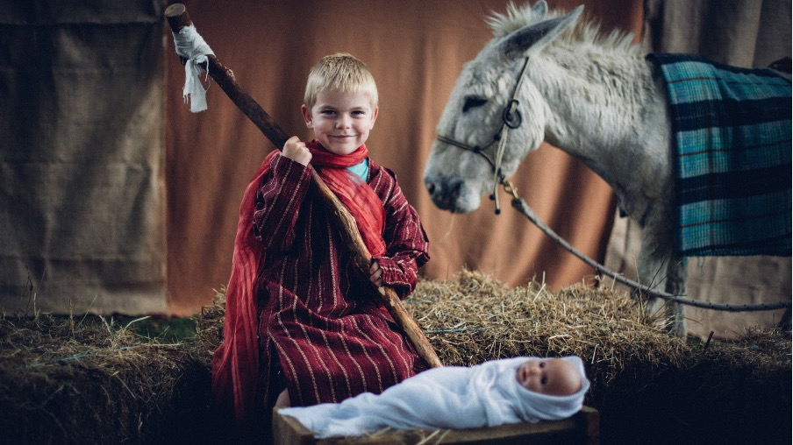
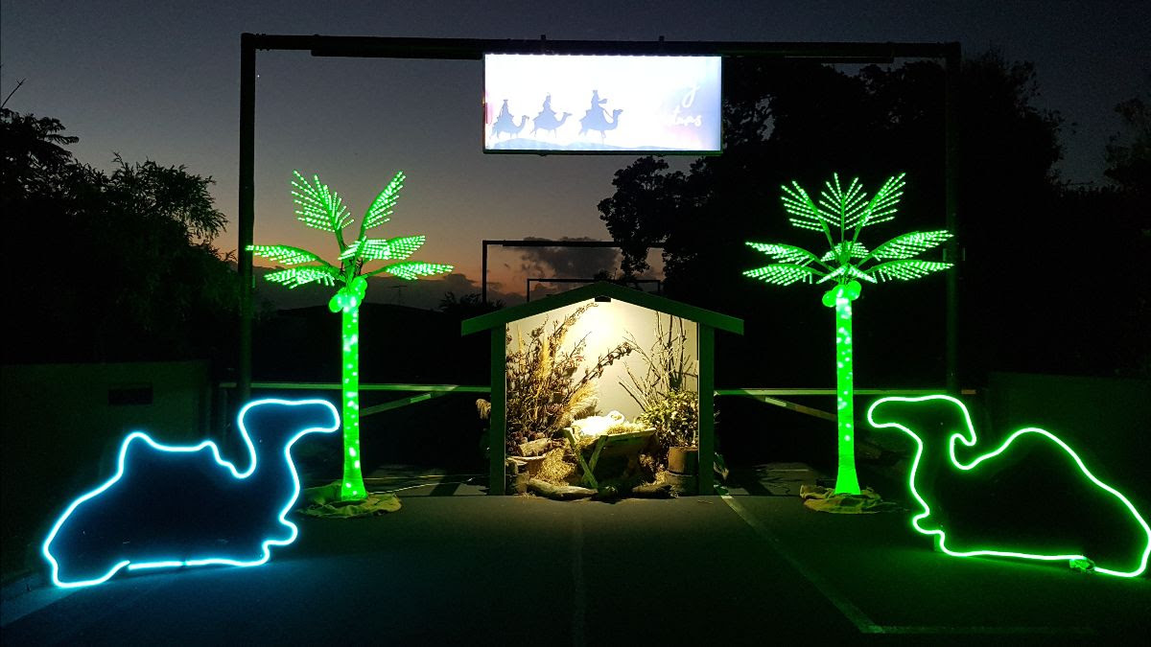
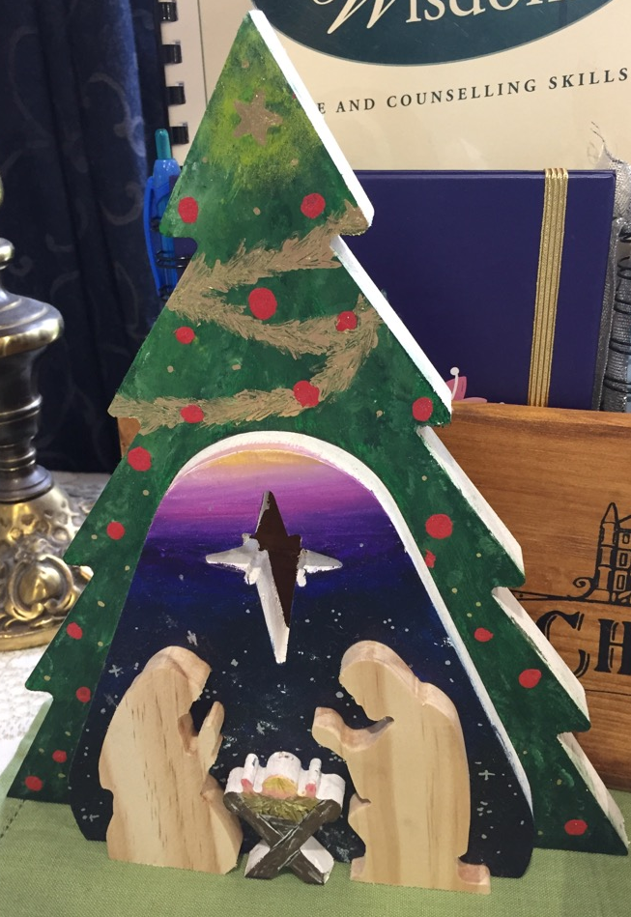
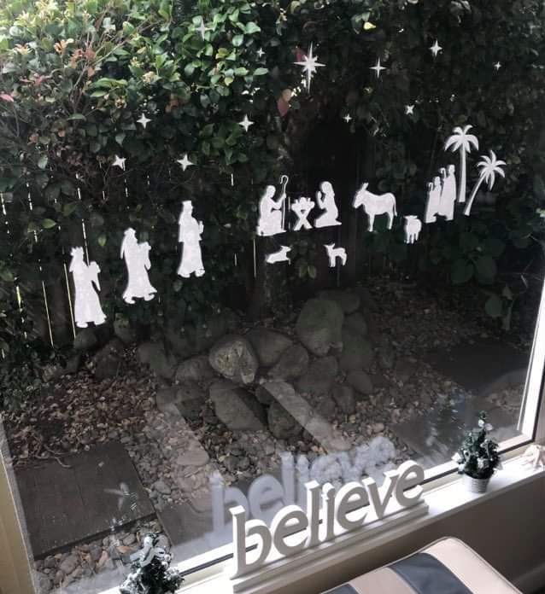
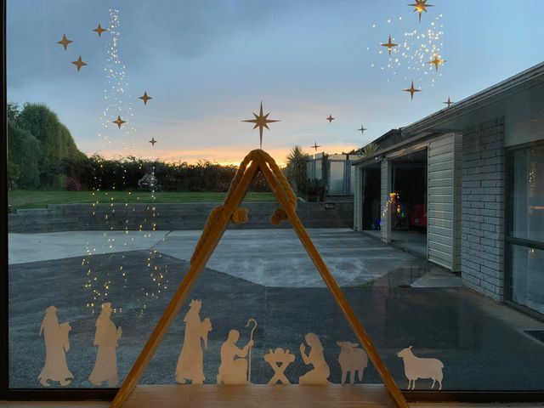
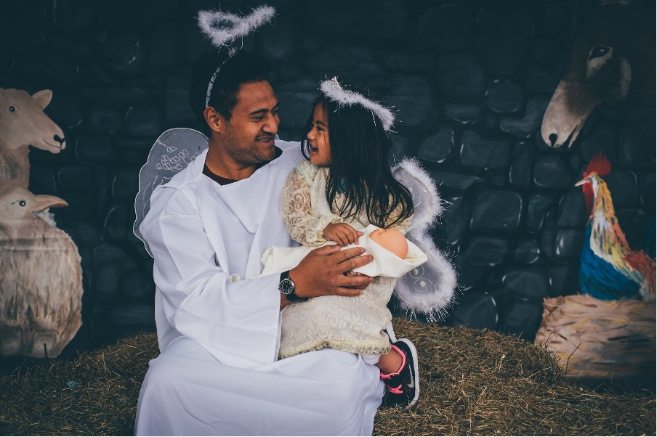
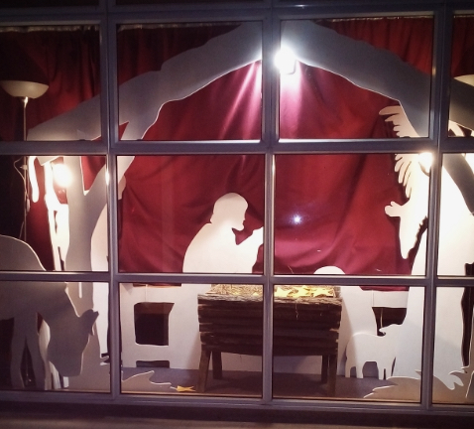
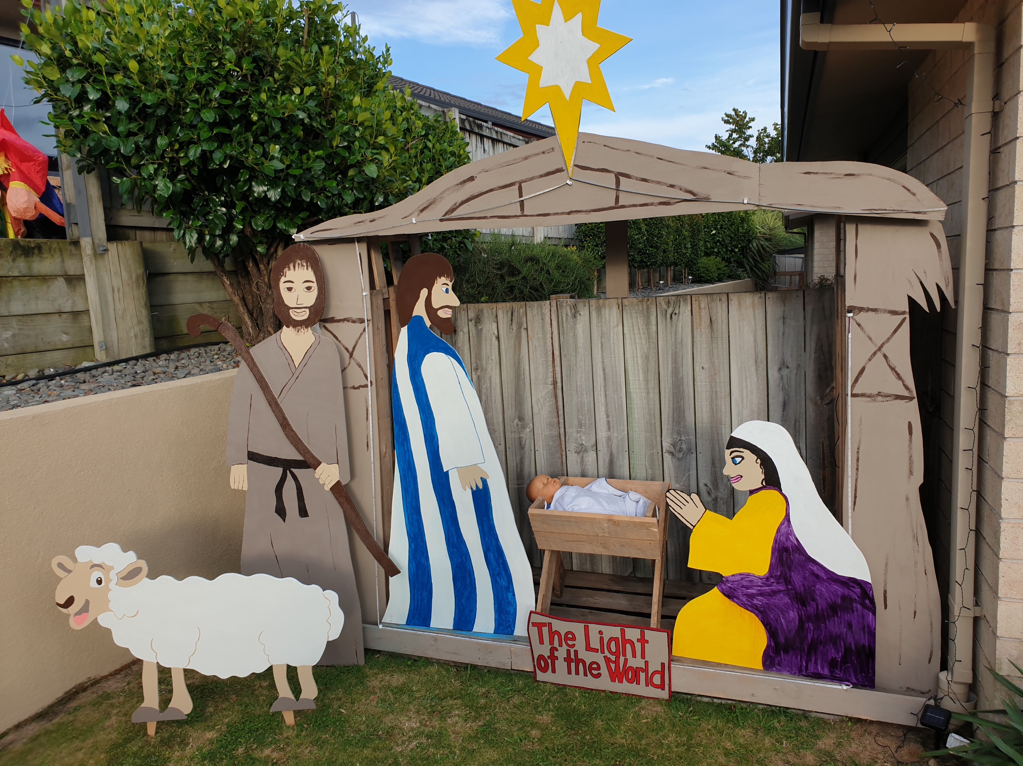
Fresh ideas from around NZ

