Slide 3
Would you like to see
the Christ back in
Christmas?

Slide 4
Hope Project Christmas aspires to make CHRIST the CENTREPIECE at Christmas by encouraging individuals to display NATIVITIES wherever they can.

Slide 5
Imagine seeing…
…nativity scenes popping up all around…
in house windows, on Christmas cards, stickered on car windows, filling social media feeds, displayed outside churches, featured in shop windows, gracing front lawns, on public TV, part of Christmas parades, in community events, illustrated in children’s books, decorating Christmas trees, and highlighted on billboards.

Slide 7
The goal:
Return nativity scenes to Christmas
Together we can!

Slide 8
1. What could we each do individually?

Slide 9
2. What could we do at work?

Slide 10
3. What could your church do?

Slide 11
4. What could we do together?

Slide 12
Let’s return nativity scenes to Christmas.
Together we can!

Slide 13
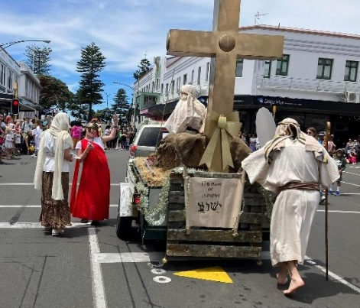
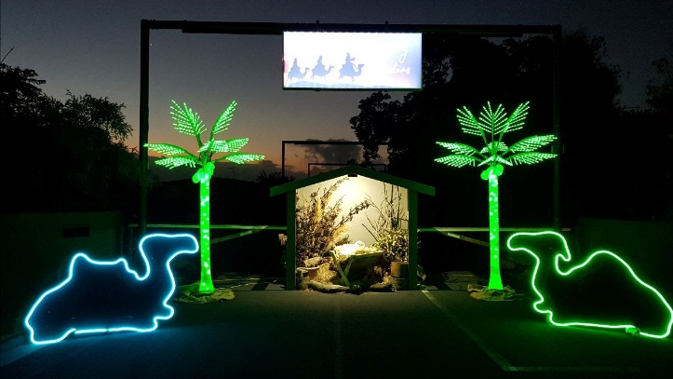
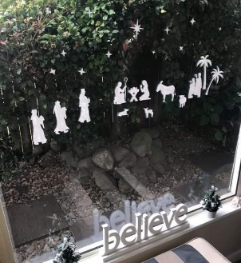
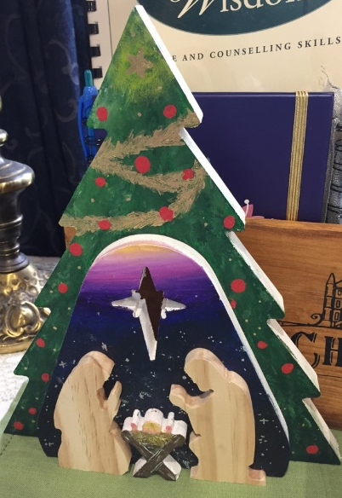
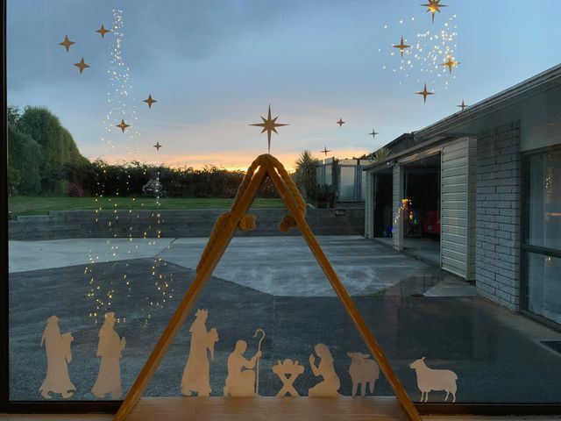
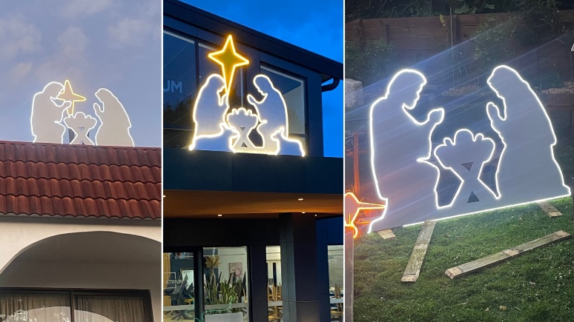
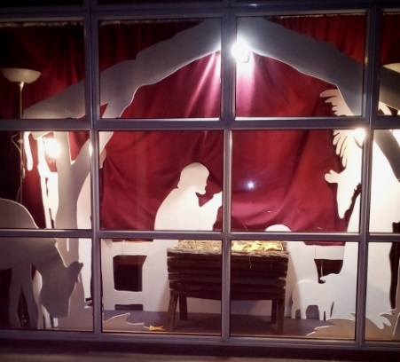
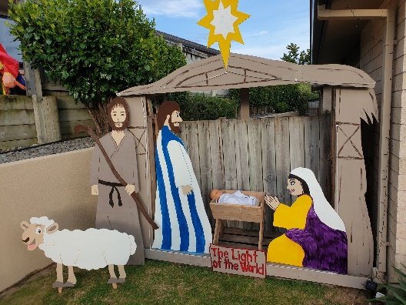
Fresh ideas from around NZ

