Slide 1

Could you please help connect more than 1.3 million Kiwis with Jesus this Easter?
AllTogether.co.nz/HopeProject

Slide 2
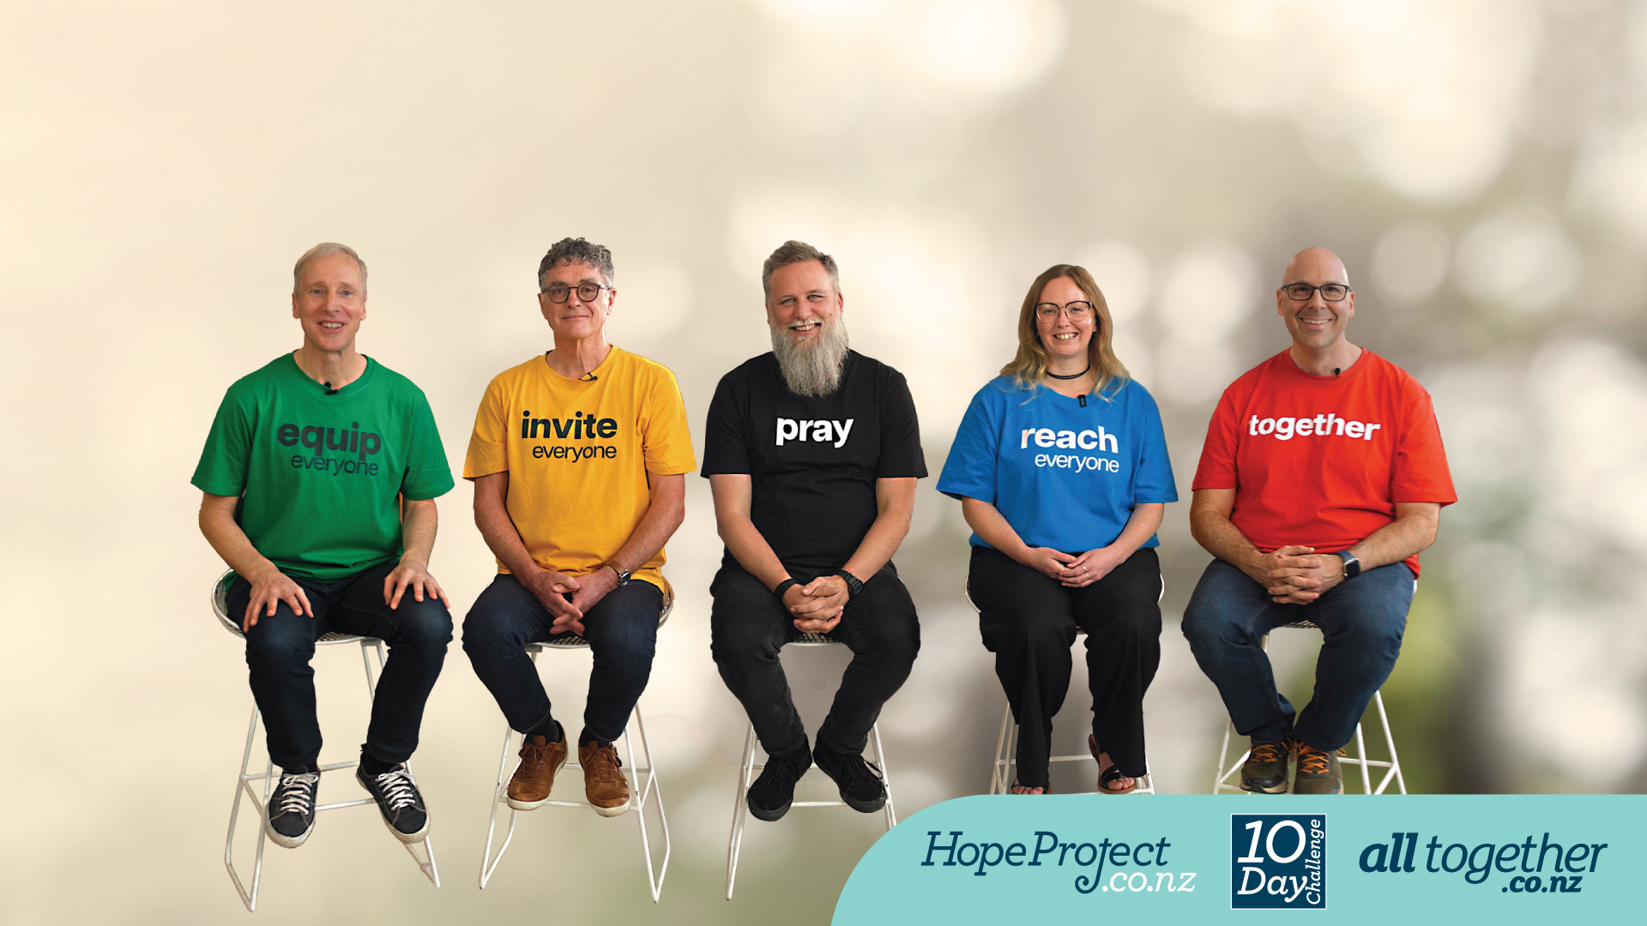
A five-point vision

Slide 3
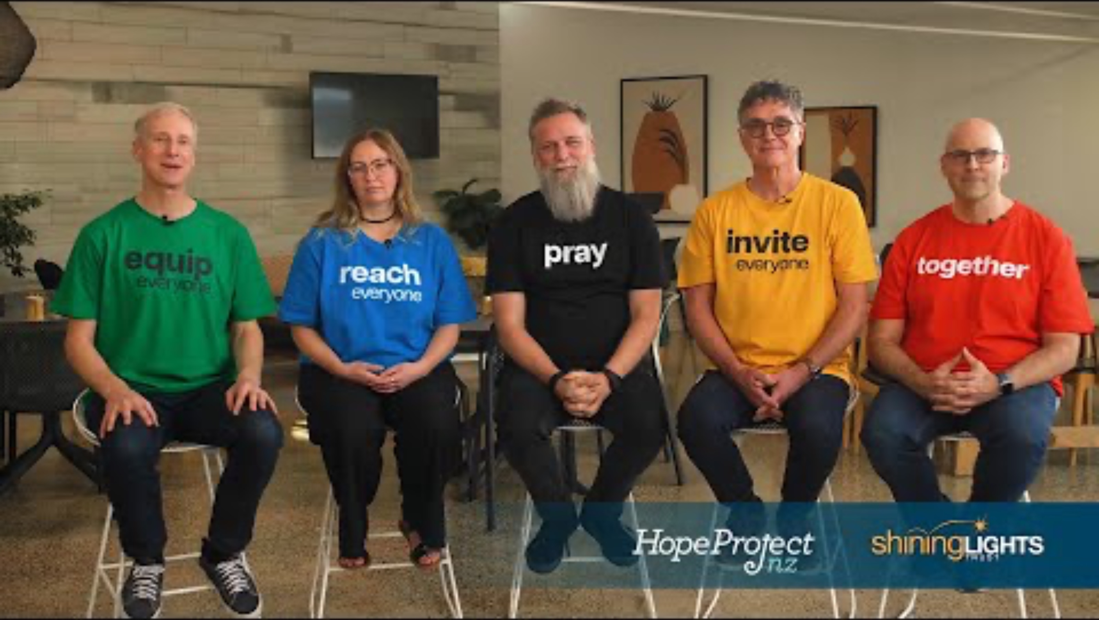
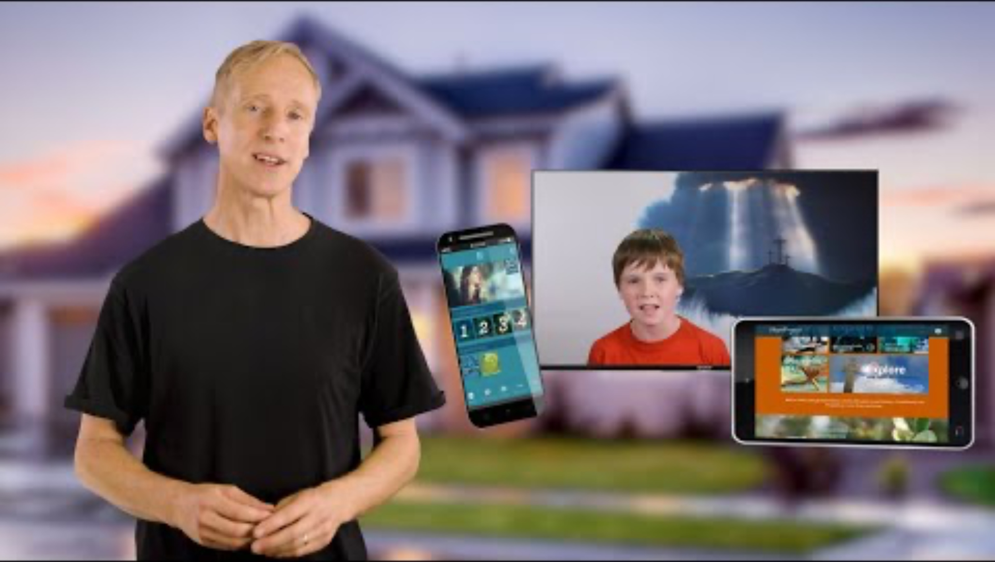

Promotional videos - THREE options
4-minute vision video
from YouTube HERE
or download Sharepoint Link to Hope Project 2026 4 minute Video
30-second summary of vision video
from YouTube HERE
or download Sharepoint Link to Hope Project 2026 30 Second Video
1-minute ‘delivery promotion’ video
from YouTube HERE
or download Sharepoint Link to Hope Project 2026 60 Second Video
Notes:
Insert video from AllTogether.co.nz/hopeproject

Slide 4
A five-point vision

Slide 5
Three steps:
Sign up so your local coordinator has your contacts
Get maps / booklets via your coordinator or local combined church prayer gathering
Go out to prayer-walk + deliver
before Easter

Slide 6
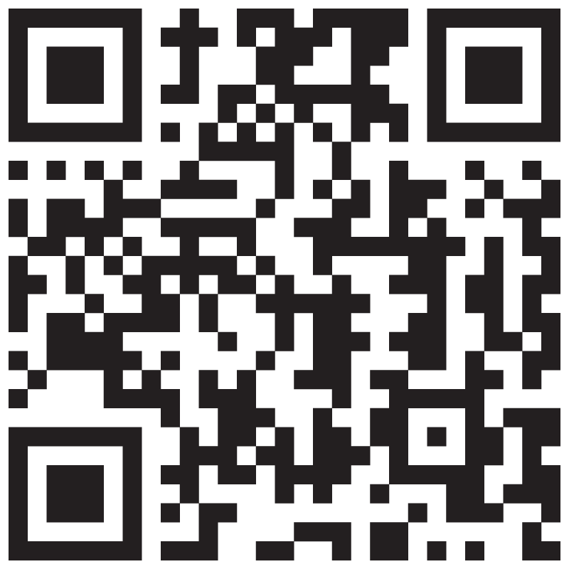
Nationally:
Reach 1.3 million households with the gospel
AllTogether.co.nz/Volunteer

Slide 7
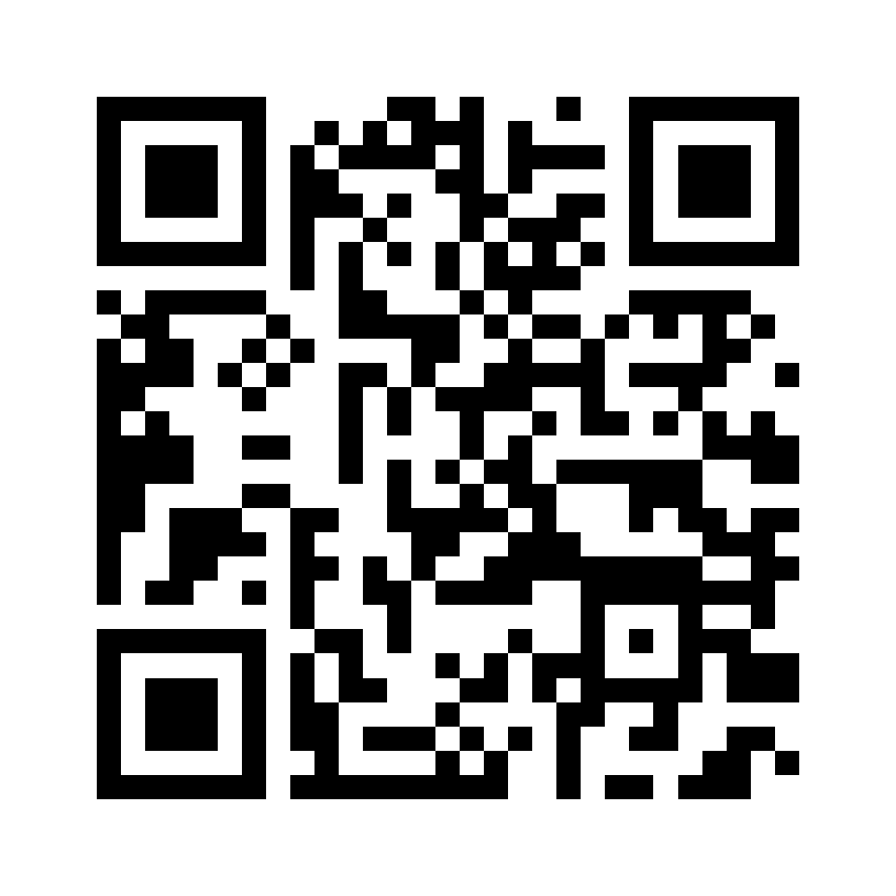
For Auckland: Reach 350,000 households with the gospel
AllTogether.co.nz/Auckland

Slide 8
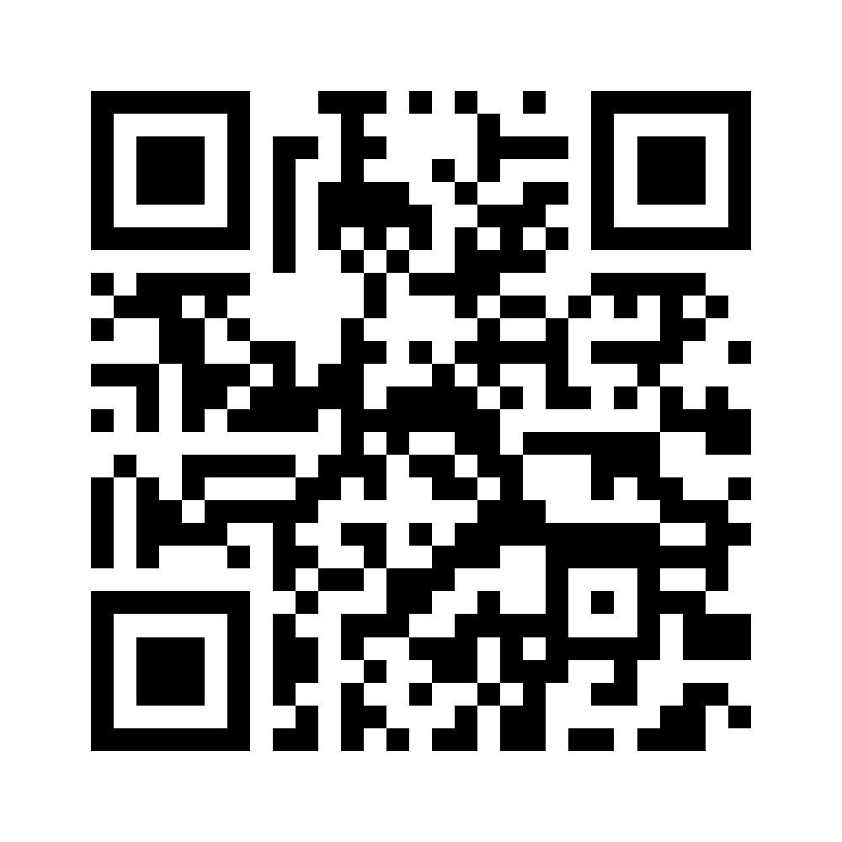
For Hamilton: Reach 40,500 households with the gospel
AllTogether.co.nz/Auckland

Slide 9
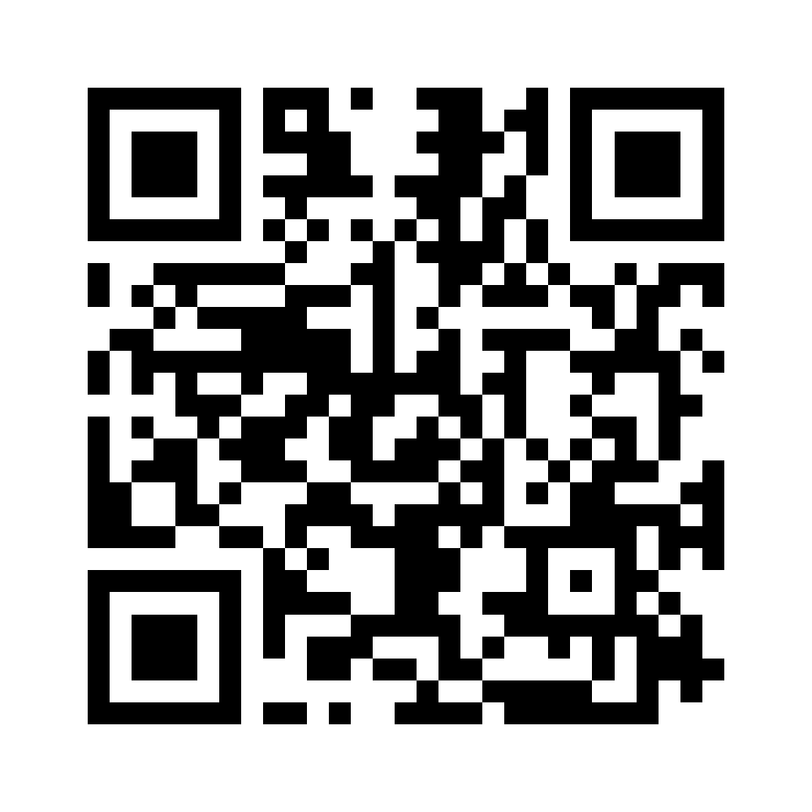
Nelson:
Reach 14,700 households with the gospel
AllTogether.co.nz/Nelson

Slide 10
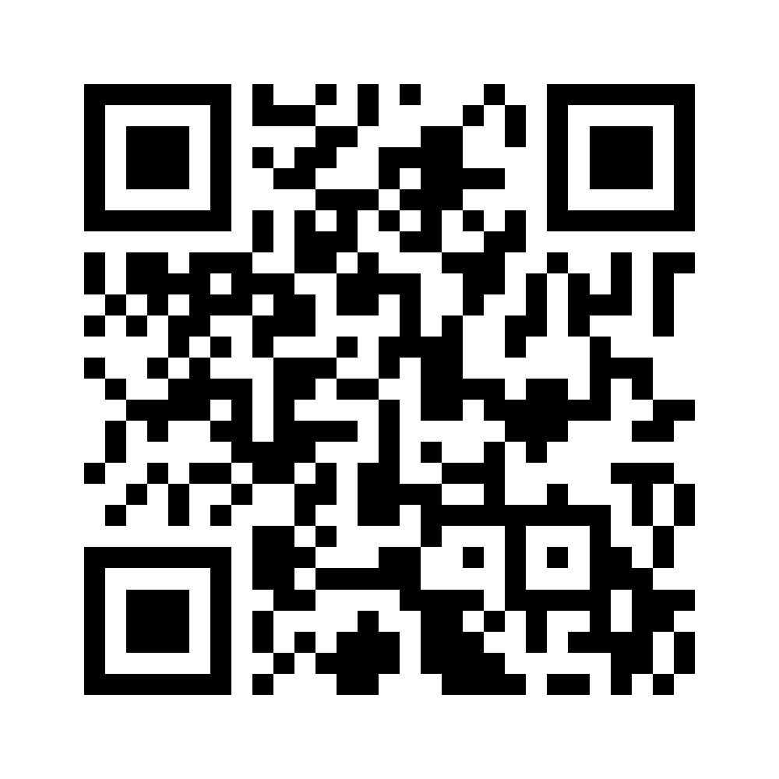
Blenheim:
Reach 9,900 households with the gospel
AllTogether.co.nz/Blenheim

Slide 11
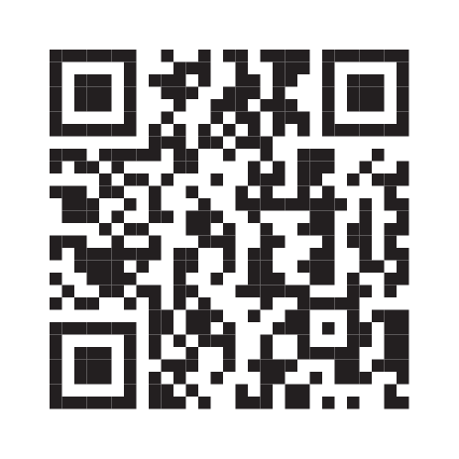
Christchurch:
Reach 105,000 households with the gospel
AllTogether.co.nz/Christchurch

Slide 12
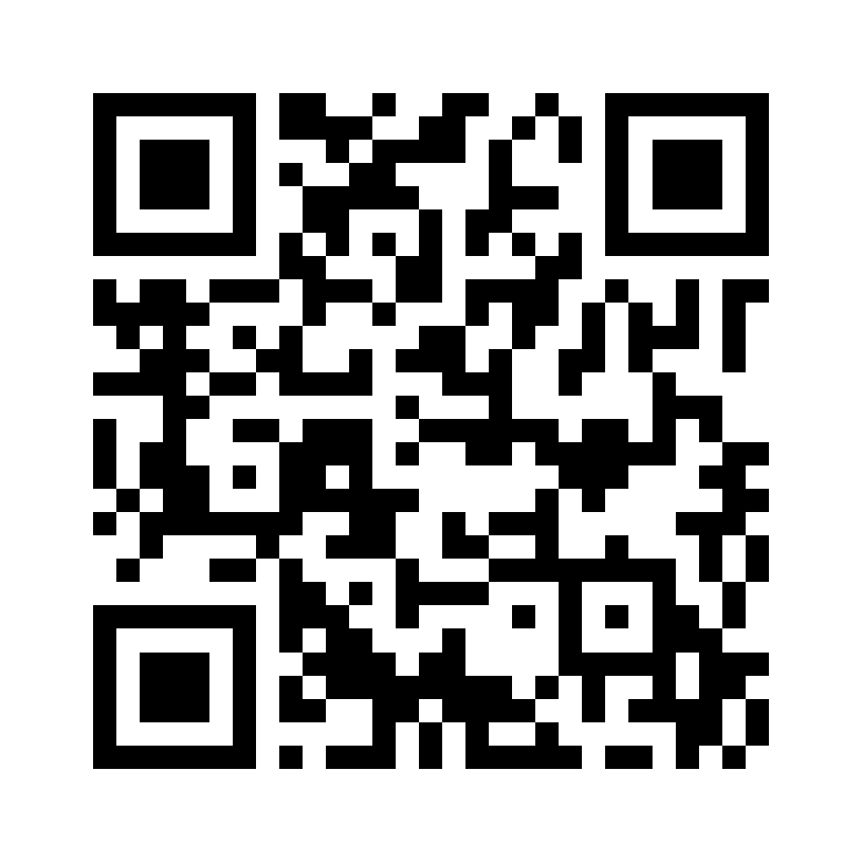
Dunedin:
Reach 27,000 households with the gospel
AllTogether.co.nz/Dunedin

Slide 13

How to help
Please volunteer for the delivery:
– Register on the clip board today
(…or online at alltogether.co.nz/volunteer)
Please donate to fund this effort:
– AllTogether.co.nz/donate
Then engage a conversation!
– The key to great conversations is great questions
– Conversations can change lives
– Find equipping videos at AllTogether.co.nz/resources

Slide 14
Online Sign-ups
AUCKLAND
HAMILTON
BLENHEIM

Slide 15
Online Sign-ups
NELSON
CHRISTCHURCH
DUNEDIN

